Slide 1
The transformation of citizens’ political attitudes and behaviour
Sofie Marien
Assistant Professor, KU Leuven & University of Amsterdam

Slide 2
Outline talk
Transformation of citizen political participation & trust: trends
Why care about these trends?
How to address these transformations?

Slide 3
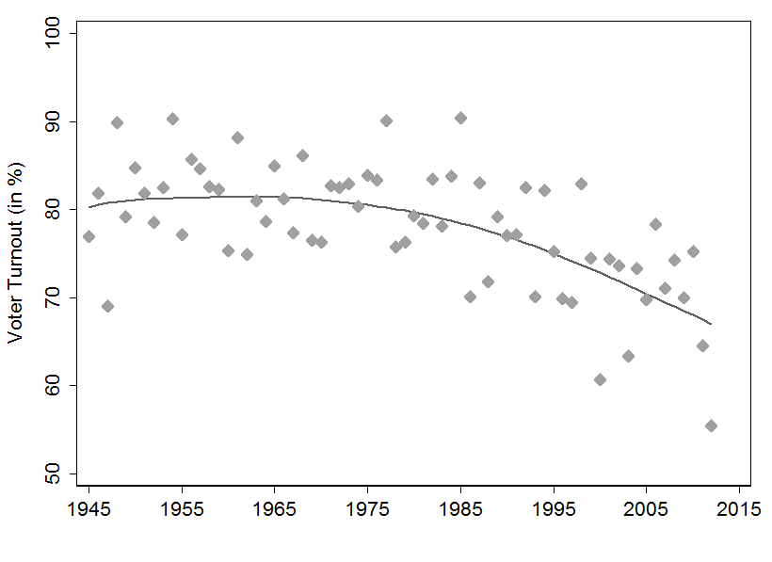
Concerns about democratic legitimacy
Drop in voter turnout
Hooghe & Kern 2016

Slide 4
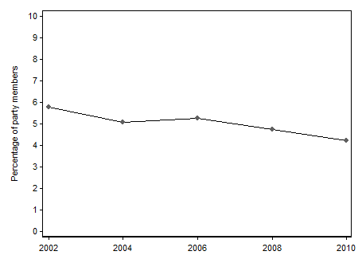
Party membership
Going, going, … gone?
Van Biezen, Mair & Poguntke 2012
Is the party over?
Whiteley 2011
Van Haute (2011, ed), Mair & Van Biezen (2001), Katz et al (1992)
Hooghe & Kern 2016

Slide 5
Concern by some…
“A decline in their [political parties] voluntary base has important implications for the future of democracy. Such a decline is likely to weaken civil society by undermining key relationships between citizens and the state, many of which are sustained by political parties.”
(Whiteley 2011, p.22)

Slide 6
… but not all
“Despite a growing body of literature concerning a decline in political activism in post-industrial societies, our findings indicate that the upward tendency of protest politics […] has materialized, producing a sustained and systematic increase in elite-challenging activities during the last quarter of the twentieth century. While less than half of the eight publics engaged in at least one activity in 1981, more than two-thirds were involved in 2000.”
(Inglehart & Catterberg, 2002, p.313/314)

Slide 7
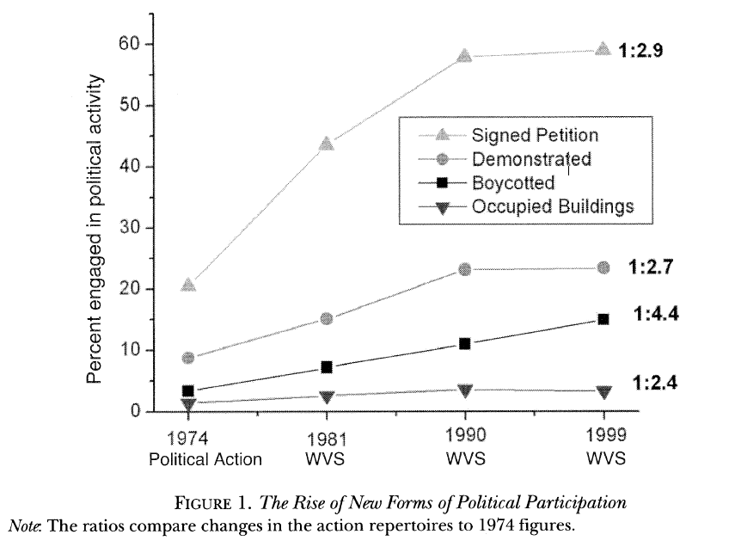
Transformation
Different mobilisation and participation
More informal
Focused on (novel) issues
More individual
Leads to debates about definition participation. What is political participation and what is not? (Symposium Acta Politica 2014)
Stolle, Hooghe, Micheletti 2005

Slide 8
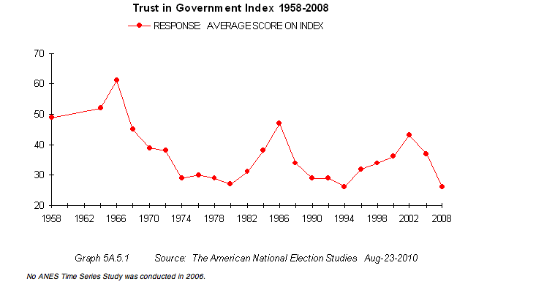
More reason for concern?
ANES: http://www.electionstudies.org

Slide 9
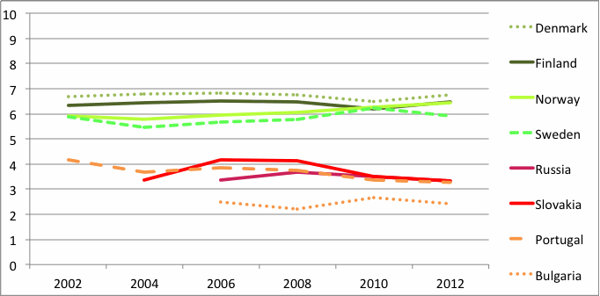
American exceptionalism?
European Social Survey: http://www.europeansocialsurvey.org
Trends under debate (depends on country, object of trust). Dissatisfaction about functioning political system, whether this is new: less clear (e.g. Rosanvallon 2006)

Slide 10
Should we be concerned?
Why is political participation important?
Can ‘new’ forms take up these functions? Are they functional equivalents?

Slide 11
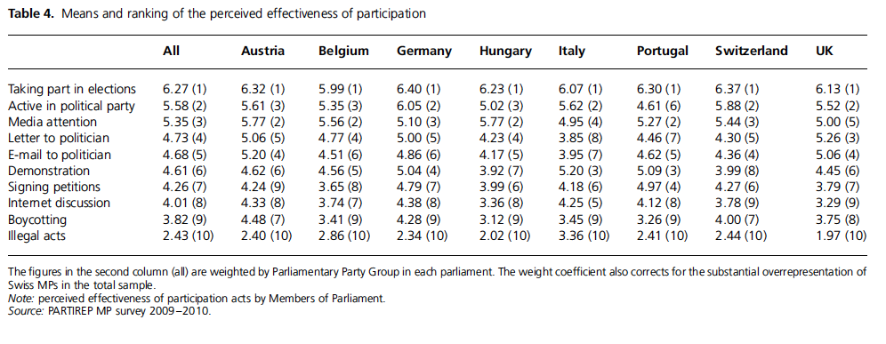
As effective in influencing policy?
Hooghe & Marien 2014

Slide 12

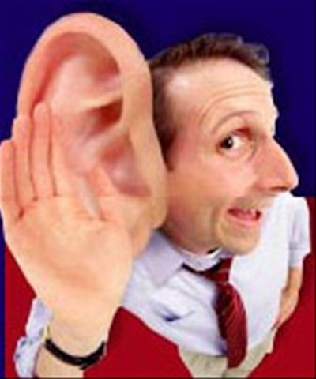
 | Citizens | MPs | Rank Citizens | Rank MPs | Difference
Taking part in elections | 5.05 | 6.02 | 1 | 1 | 0
Membership voluntary organizations | 3.92 | 4.74 | 2 | 5 | -3
Signing petitions | 3.76 | 3.69 | 3 | 9 | -6
Joining a political party | 3.67 | 5.38 | 4 | 3 | 1
Media attention | 3.67 | 5.59 | 5 | 2 | 3
Demonstration | 3.52 | 4.64 | 6 | 6 | 0
Boycotting | 3.31 | 3.41 | 7 | 10 | -3
Letter to politician | 3.04 | 4.82 | 8 | 4 | 4
Email to politician | 2.90 | 4.52 | 9 | 7 | 2
Internet discussion | 2.56 | 3.75 | 10 | 8 | 2
Illegal acts | 2.35 | 2.88 | 11 | 11 | 0
N | 2,317 | 165

Slide 13
 | Citizens | MPs | Rank Citizens | Rank MPs | Difference
Taking part in elections | 5.05 | 6.02 | 1 | 1 | 0
Membership voluntary organizations | 3.92 | 4.74 | 2 | 5 | -3
Signing petitions | 3.76 | 3.69 | 3 | 9 | -6
Joining a political party | 3.67 | 5.38 | 4 | 3 | 1
Media attention | 3.67 | 5.59 | 5 | 2 | 3
Demonstration | 3.52 | 4.64 | 6 | 6 | 0
Boycotting | 3.31 | 3.41 | 7 | 10 | -3
Letter to politician | 3.04 | 4.82 | 8 | 4 | 4
Email to politician | 2.90 | 4.52 | 9 | 7 | 2
Internet discussion | 2.56 | 3.75 | 10 | 8 | 2
Illegal acts | 2.35 | 2.88 | 11 | 11 | 0
N | 2,317 | 165

Slide 14
Should we be concerned about low trust levels?
“le peuple ne peut rester libre et commandant que s’il dispose d’une sorte de ‘réserve de défiance’, pour s’opposer si nécessaire au pouvoir qu’il a lui-même consacré’ (Rosanvallon 2006, p. 126).
Critical citizens (Norris 1999), Vigilance (Rosanvallon 2006),
Dissatisfied democrats (Norris 2011), Assertive citizens (Dalton & Welzel 2014).

Slide 15
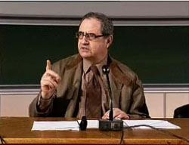
Vigilance, not trust
Democracy is based on distrust towards power
Elected
Political system= democratic institutions
Contre-démocratie
Role actors e.g. citizens, new social movements, media, internet: Surveillance (monitor, evaluate, announce), Peuple-veto (Negative role), Peuple-juge
Rosanvallon 2006

Slide 16
No, trust
Classical work: trust critical resource (e.g. part civic culture Almond & Verba, 1963)
David Easton (1965): dominant framework
Demands
Political system
Decisions
Actions
Support

Slide 17
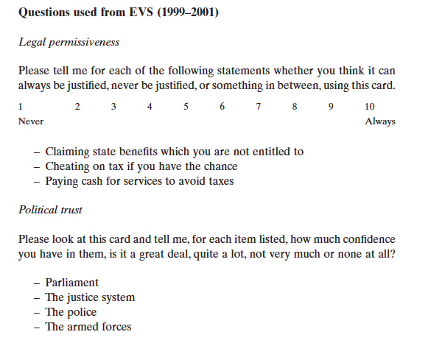
Test Easton framework
Data: http://www.europeanvaluesstudy.eu
(Marien & Hooghe, 2011 EJPR)

Slide 18
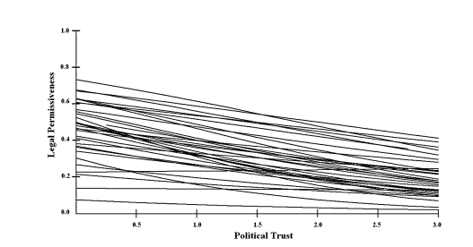

Slide 19
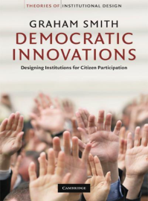
How can we address transformation?
Transform system through democratic innovations? (e.g. Dalton & Welzel 2014; Newton & Geissel 2012; Smith 2009)
Democratic innovations: “institutions that have been specifically designed to increase and deepen citizen participation in the political decision-making process” (Smith 2009, p.1)
Can they increase legitimacy? e.g. increase satisfaction with functioning democracy/trust?

Slide 20
Democratic innovation as a solution?
Little is known
Mixed evidence
Methodological problems: how to asses causal effect and causal mechanism?

Slide 21
New study with novel research design
Random sample based on the city’s register of residents
1,049 consistent and correct respondents
Strengths:
  Causality: panel data & Comparison group
  Ecological validity
 | Wave 1 | Wave 2 |  | Wave 3
 | Pre-Test | Referendum | Post-Test 1 | Post-Test 2
TG | O₁ | X | O₂ | O₃
CG | O₄ |  |  | O₅
 | 1,360 (38 %) |  |  | 1,119 (31 %)

Slide 22
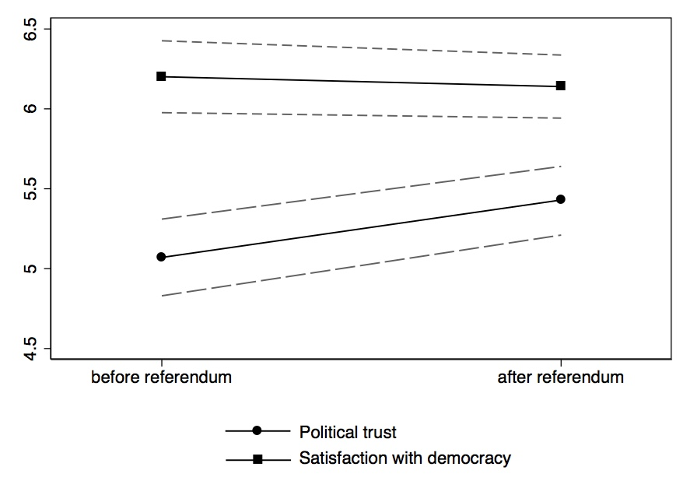
Trends over time
Change in political trust and satisfaction with democracy in the treatment group
Diff-in-diff shows weaker increase in trust and drop in satisfaction

Slide 23
Results Diff in Diff
Comparison of the difference between the two pre-post differences in trust and democratic satisfaction
 |  | TG | CG | Difference TG-CG
Local Political Trust | before the referendum | 5.07 | 5.44 | -0.37**
 | after the referendum | 5.43 | 5.63 | 0.20
 | Change | 0.36** | 0.19 | 0.17
Satisfaction with Local Democracy | before the referendum | 6.20 | 6.71 | -0.51***
 | after the referendum | 6.14 | 6.20 | -0.06
 | Change | -0.06 | -0.51*** | 0.45**

Slide 24
What could explain increase?
Increase among voters
Change in: | Voters | Non voters | Comparison group
Satisfaction with democracy | 0.21ª | -0.38^{b} | -0.49^{b}
Trust in local political institutions | 0.55^{c} | 0.11^{d} | 0.19^{d}
Note: Differences are tested with two ANOVA tests that both revealed significant results at the 0.05 level. Sheffe posthoc tests are visualized by letters (a and b for democratic satisfaction posthoc tests. C and d for trust posthoc tests). Coefficients with the different letters differ significantly at the 0.05 level.

Slide 25
Why does voting increase trust and democratic satisfaction?
 | Change in satisfaction with local democracy |  |  | Change in trust in local institutions
 | I | II | III | IV | V | VI
Voted | 0.583*** | 0.522** |  | 0.439** | 0.344*
 | (0.164) | (0.172) |  | (0.146) | (0.158)
Perceived honesty |  | 0.003 |  |  | -0.045
referendum |  | (0.064) |  |  | (0.051)
Perceived influence |  | 0.020 |  |  | 0.052
decision |  | (0.052) |  |  | (0.042)
Perceived quality |  | 0.101 |  |  | 0.056
decision |  | (0.054) |  |  | (0.052)
Participation in referendum
(ref. not voted)
Loser |  |  | -0.015 |  |  | 0.354
 |  |  | (0.180) |  |  | (0.183)
Winner |  |  | 1.044*** |  |  | 0.507**
 |  |  | (0.209) |  |  | (0.181)
N | 467 | 457 | 461 | 463 | 453 | 457
adj. R² | 0.024 | 0.034 | 0.065 | 0.017 | 0.017 | 0.016

Slide 26
The winner takes it all
 | Change in satisfaction with local democracy |  | Change in trust in local institutions
 | I |  | II
Participation in referendum
(ref. not eligible to vote)
Non-voters | 0.132 | (0.128) | -0.069 | (0.124)
Loser | 0.117 | (0.157) | 0.285 | (0.168)
Winner | 1.176*** | (0.190) | 0.438**
Constant | -0.509*** | (0.066) | 0.177*** | 0.072
N | 1016 0.049 |  | 1000 0.008
adj. R²

Slide 27
Conclusion
Increase in democratic satisfaction in cross-sectional studies not necessarily due to increased fairness or influence.
Winners direct vote more satisfied and trusting after involvement: implications?
Deliberation more potential to increase democratic legitimacy than direct vote?
Institutions need to be adapted to 21th century with forms of participation that are more aligned with preferences contemporary citizens. Potential to increase democratic satisfaction (but not easy, politics about conflict and losses)

